Slide 1


School Cafeteria Sorting is Easy!

Slide 2
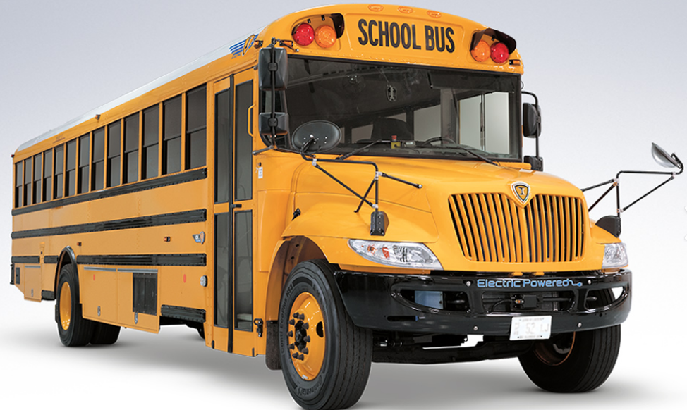
Amounts
Students make 14,500 tons of garbage per day.
That is the same weight as 2,000 school buses!
World Wildlife Federation estimates that each student in King County wastes 44 pounds of food per year at school. That is a lot!
Food Waste Warriors | Stories | WWF

Slide 3
Why is reducing waste, recycling, and composting at school important?
Notes:
Ask students.
Some answers: conserves natural resources, reduces wastes, cuts greenhouse emissions, allows us to make new products out of items that would be tossed, saves money, saves water, helps us keep water and air clean, helps wildlife, plus much much more!

Slide 4

We are EXCITED to announce- we are starting recycling and composting in the cafeteria this year!
Let’s become experts on where items go!

Slide 5
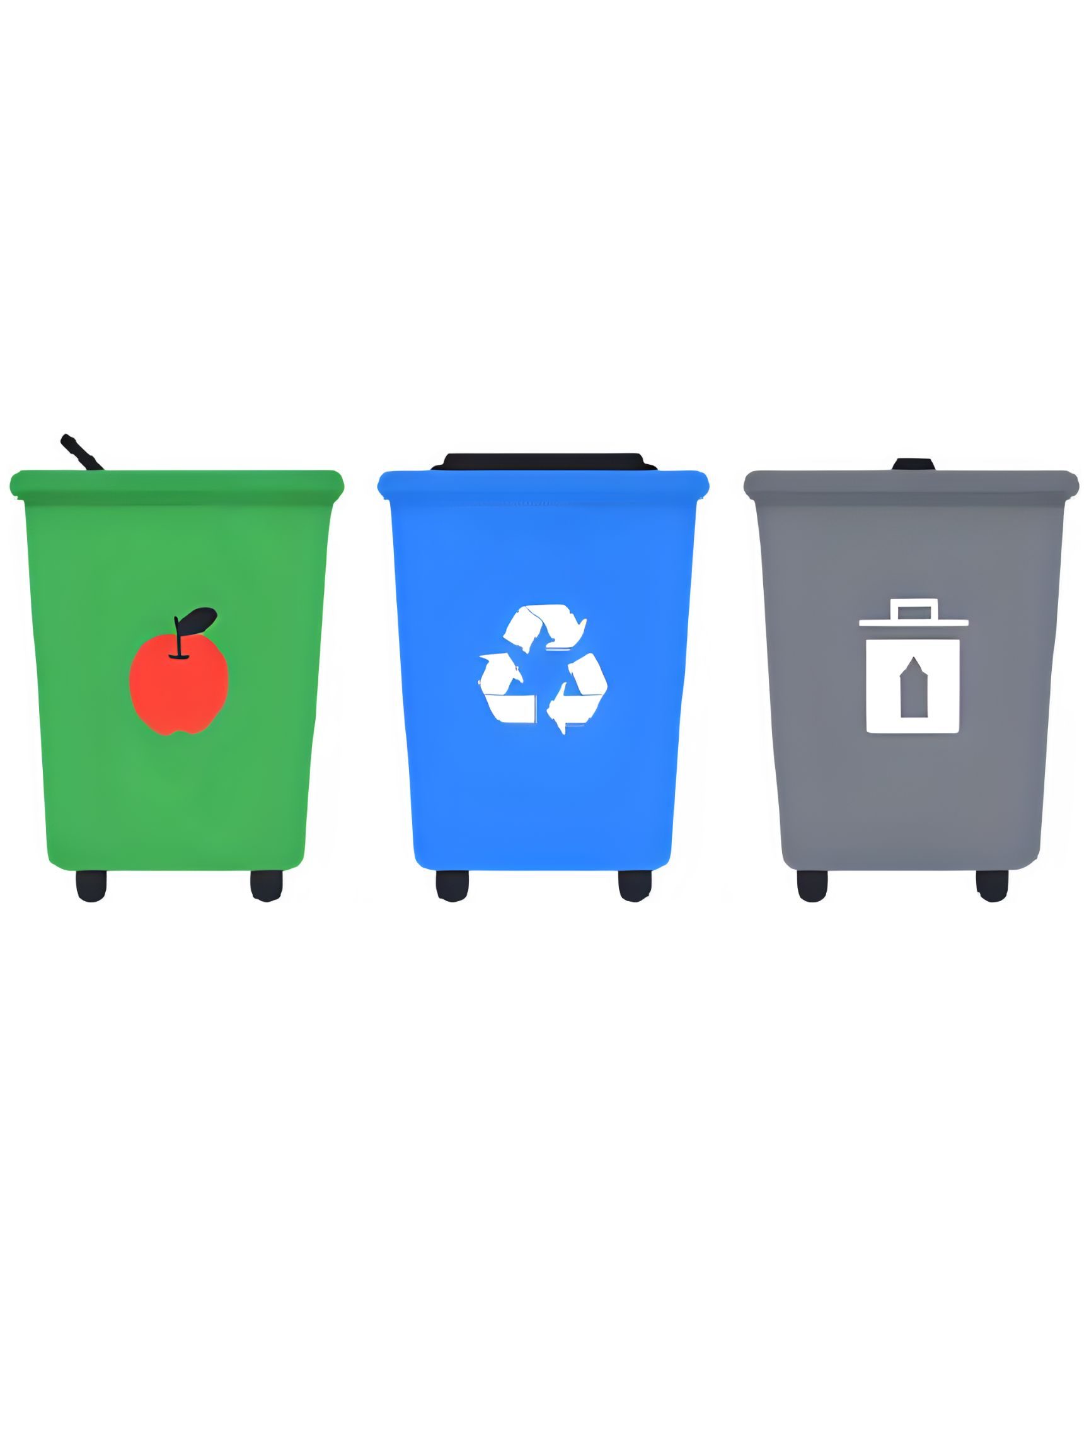
You will see 3 containers in the cafeteria.
What type of container is each color?
Green? Blue? Grey?

Slide 6


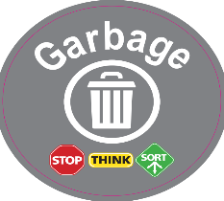
Green is for compost/organics
Blue is for recycle
Grey is for garbage
Notes:
Green is for compost/organics/food scraps; blue is for recycling and gray for garbage
All containers will have clear signs on them.

Slide 7
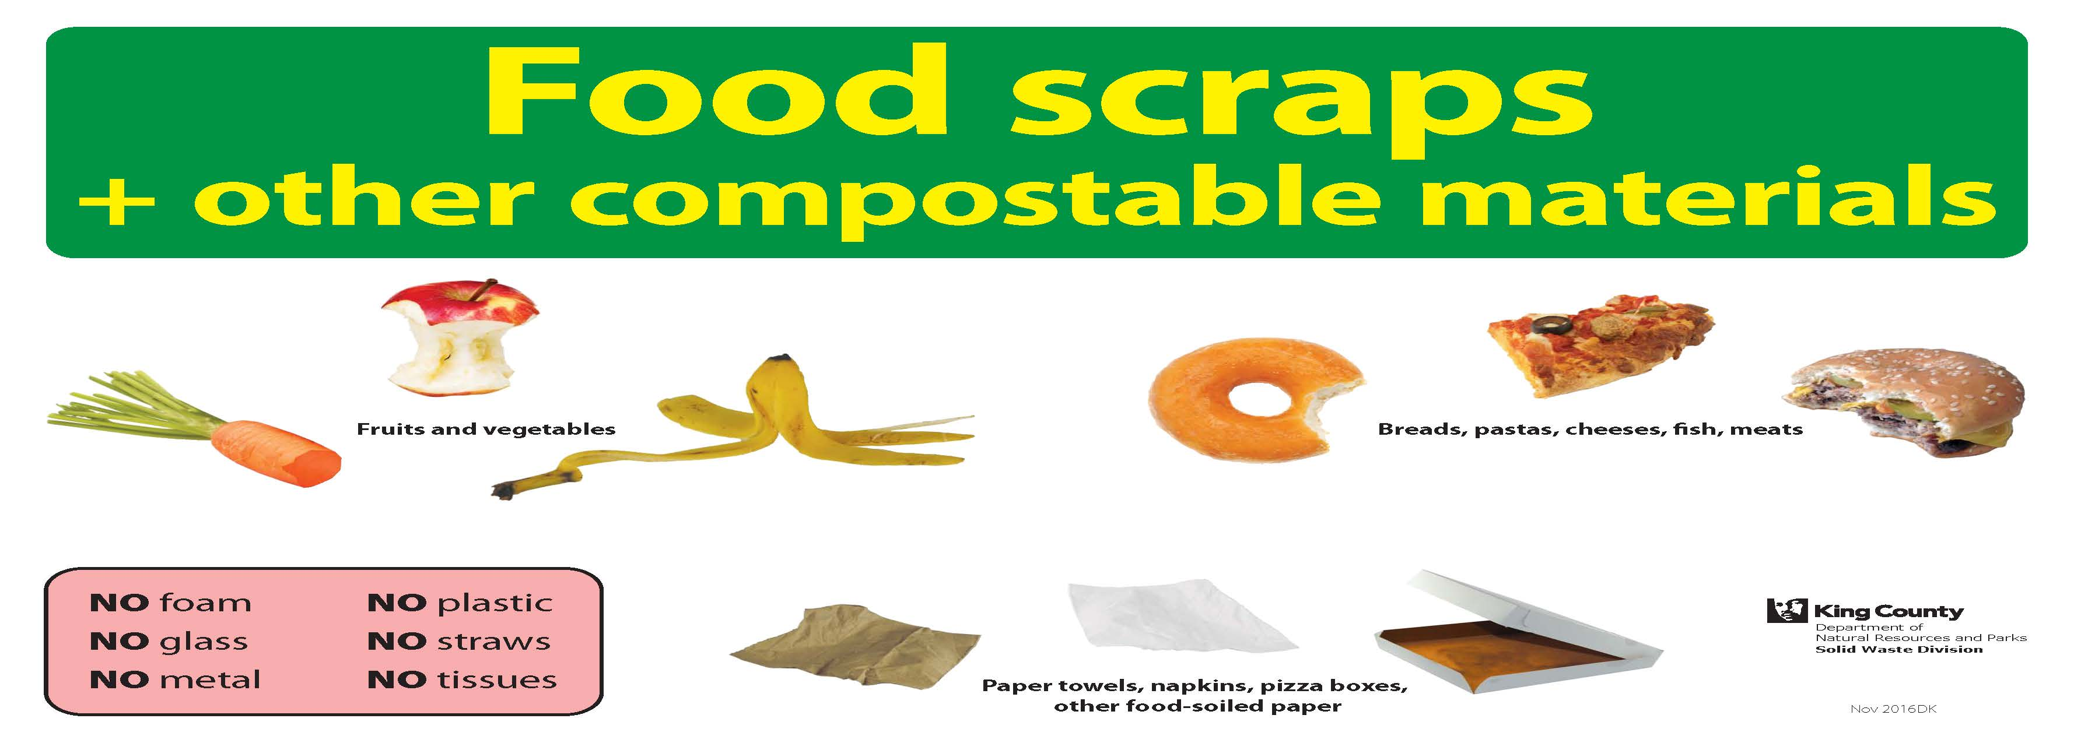
Green is for compost/organics
Notes:
Green is for compost. We may also call it food scraps or organics collection. At home it may be called yard waste. They are all the same thing. What items do you see on this sign? What is accepted in this container?
This container is for food we cannot eat, napkins and pizza boxes. Meat and dairy are fine. Remember: NO PLASTIC EVER.

Slide 8
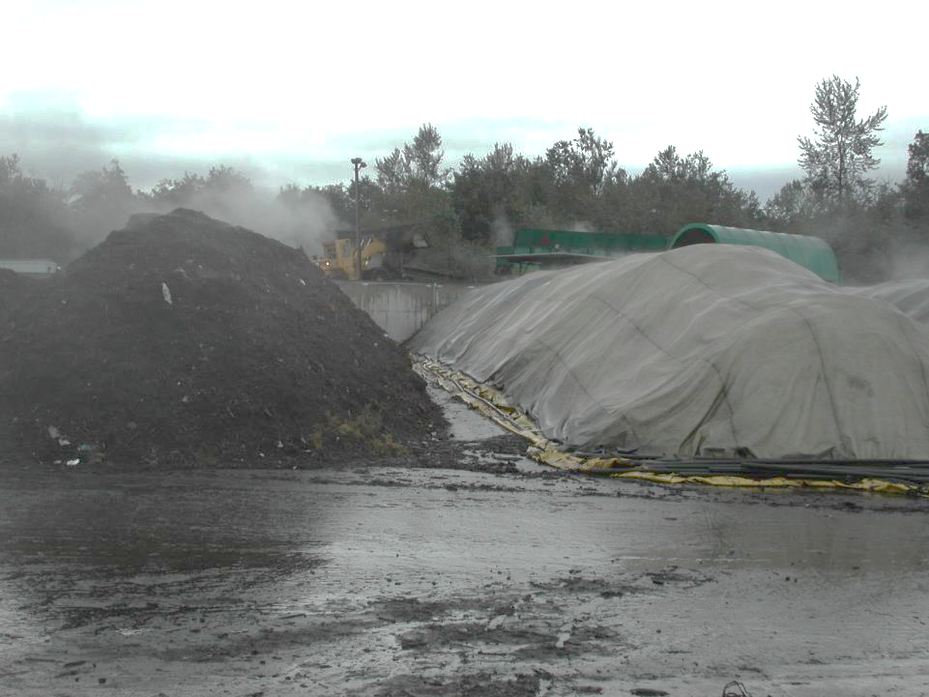
Food scraps are composted into new soil in just 8 weeks and used on local gardens.
Notes:
This container is for food we are unable to finish eating, napkins and pizza boxes. NO PLASTIC EVER. Food products are shredded and put in large piles. In just 8 weeks material breaks down into soil and is used in local landscapes and gardens. This photo was taken at local composting facility Cedar Grove composting.

Slide 9
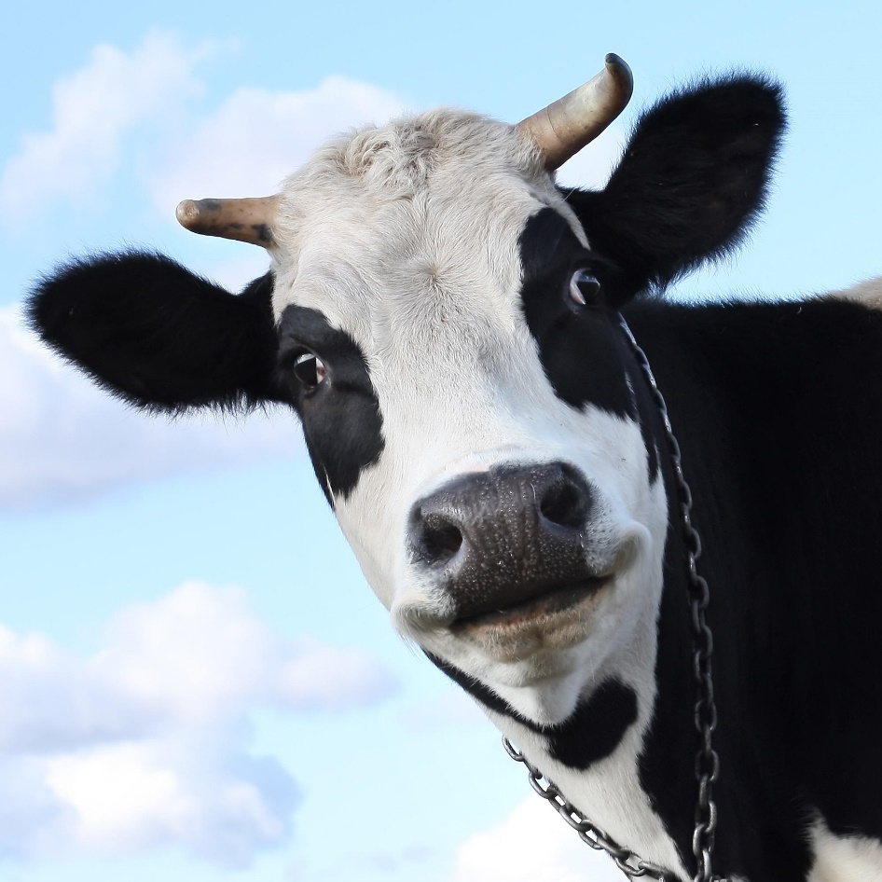
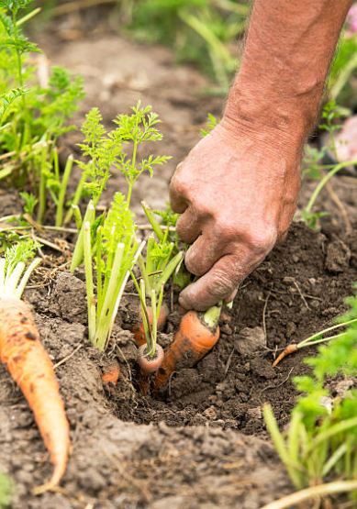
What is better than composting food?

Slide 10
What is better than composting food?
Try to eat your food and finish your milk!
Notes:
Try to finish food and finish your milk. Cows worked hard to make the milk we drink and farmers worked hard to grow the food we eat. Eating or drinking are food products is better than composting.

Slide 11
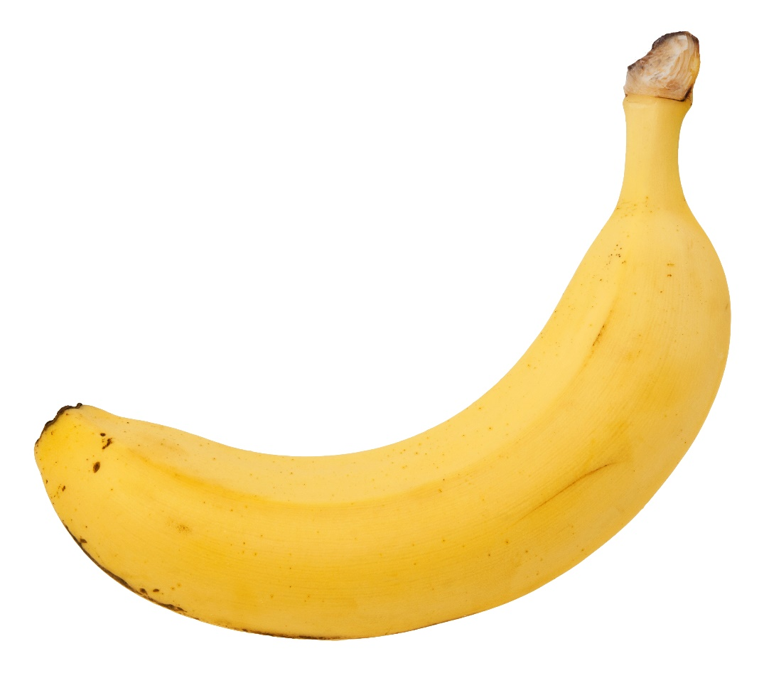
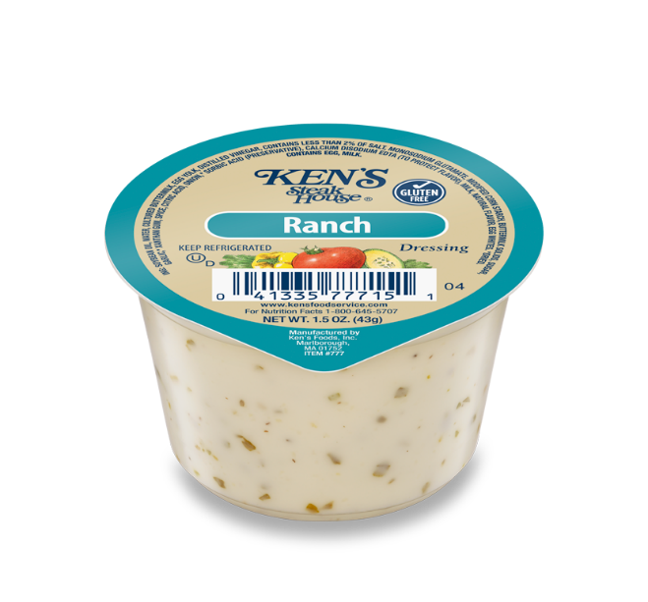
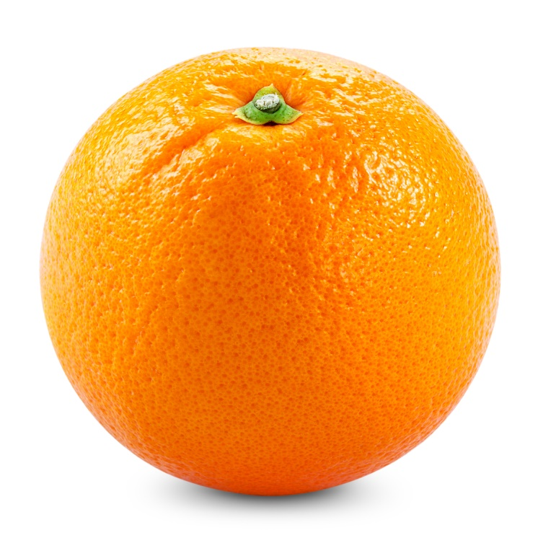
What is better than composting food?
If you cannot finish it, take it home if it is packed or if it is unopened and wrapped- place on share table if your school has one.
Notes:
If you school has a share table, foods need to be in an unopened wrapper or fruits with inedible skins (like a banana or an orange).

Slide 12
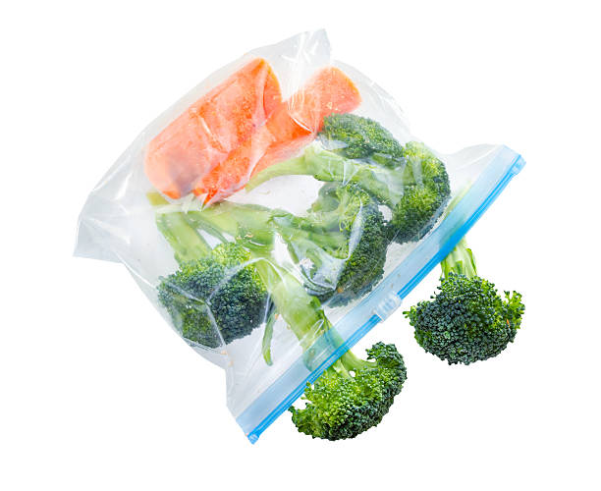
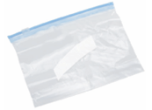
What if you opened your food?
Empty your loose food in the compost container.
Throw the empty plastic bag away.
Remember, NO PLASTIC IN THE COMPOST.

Slide 13
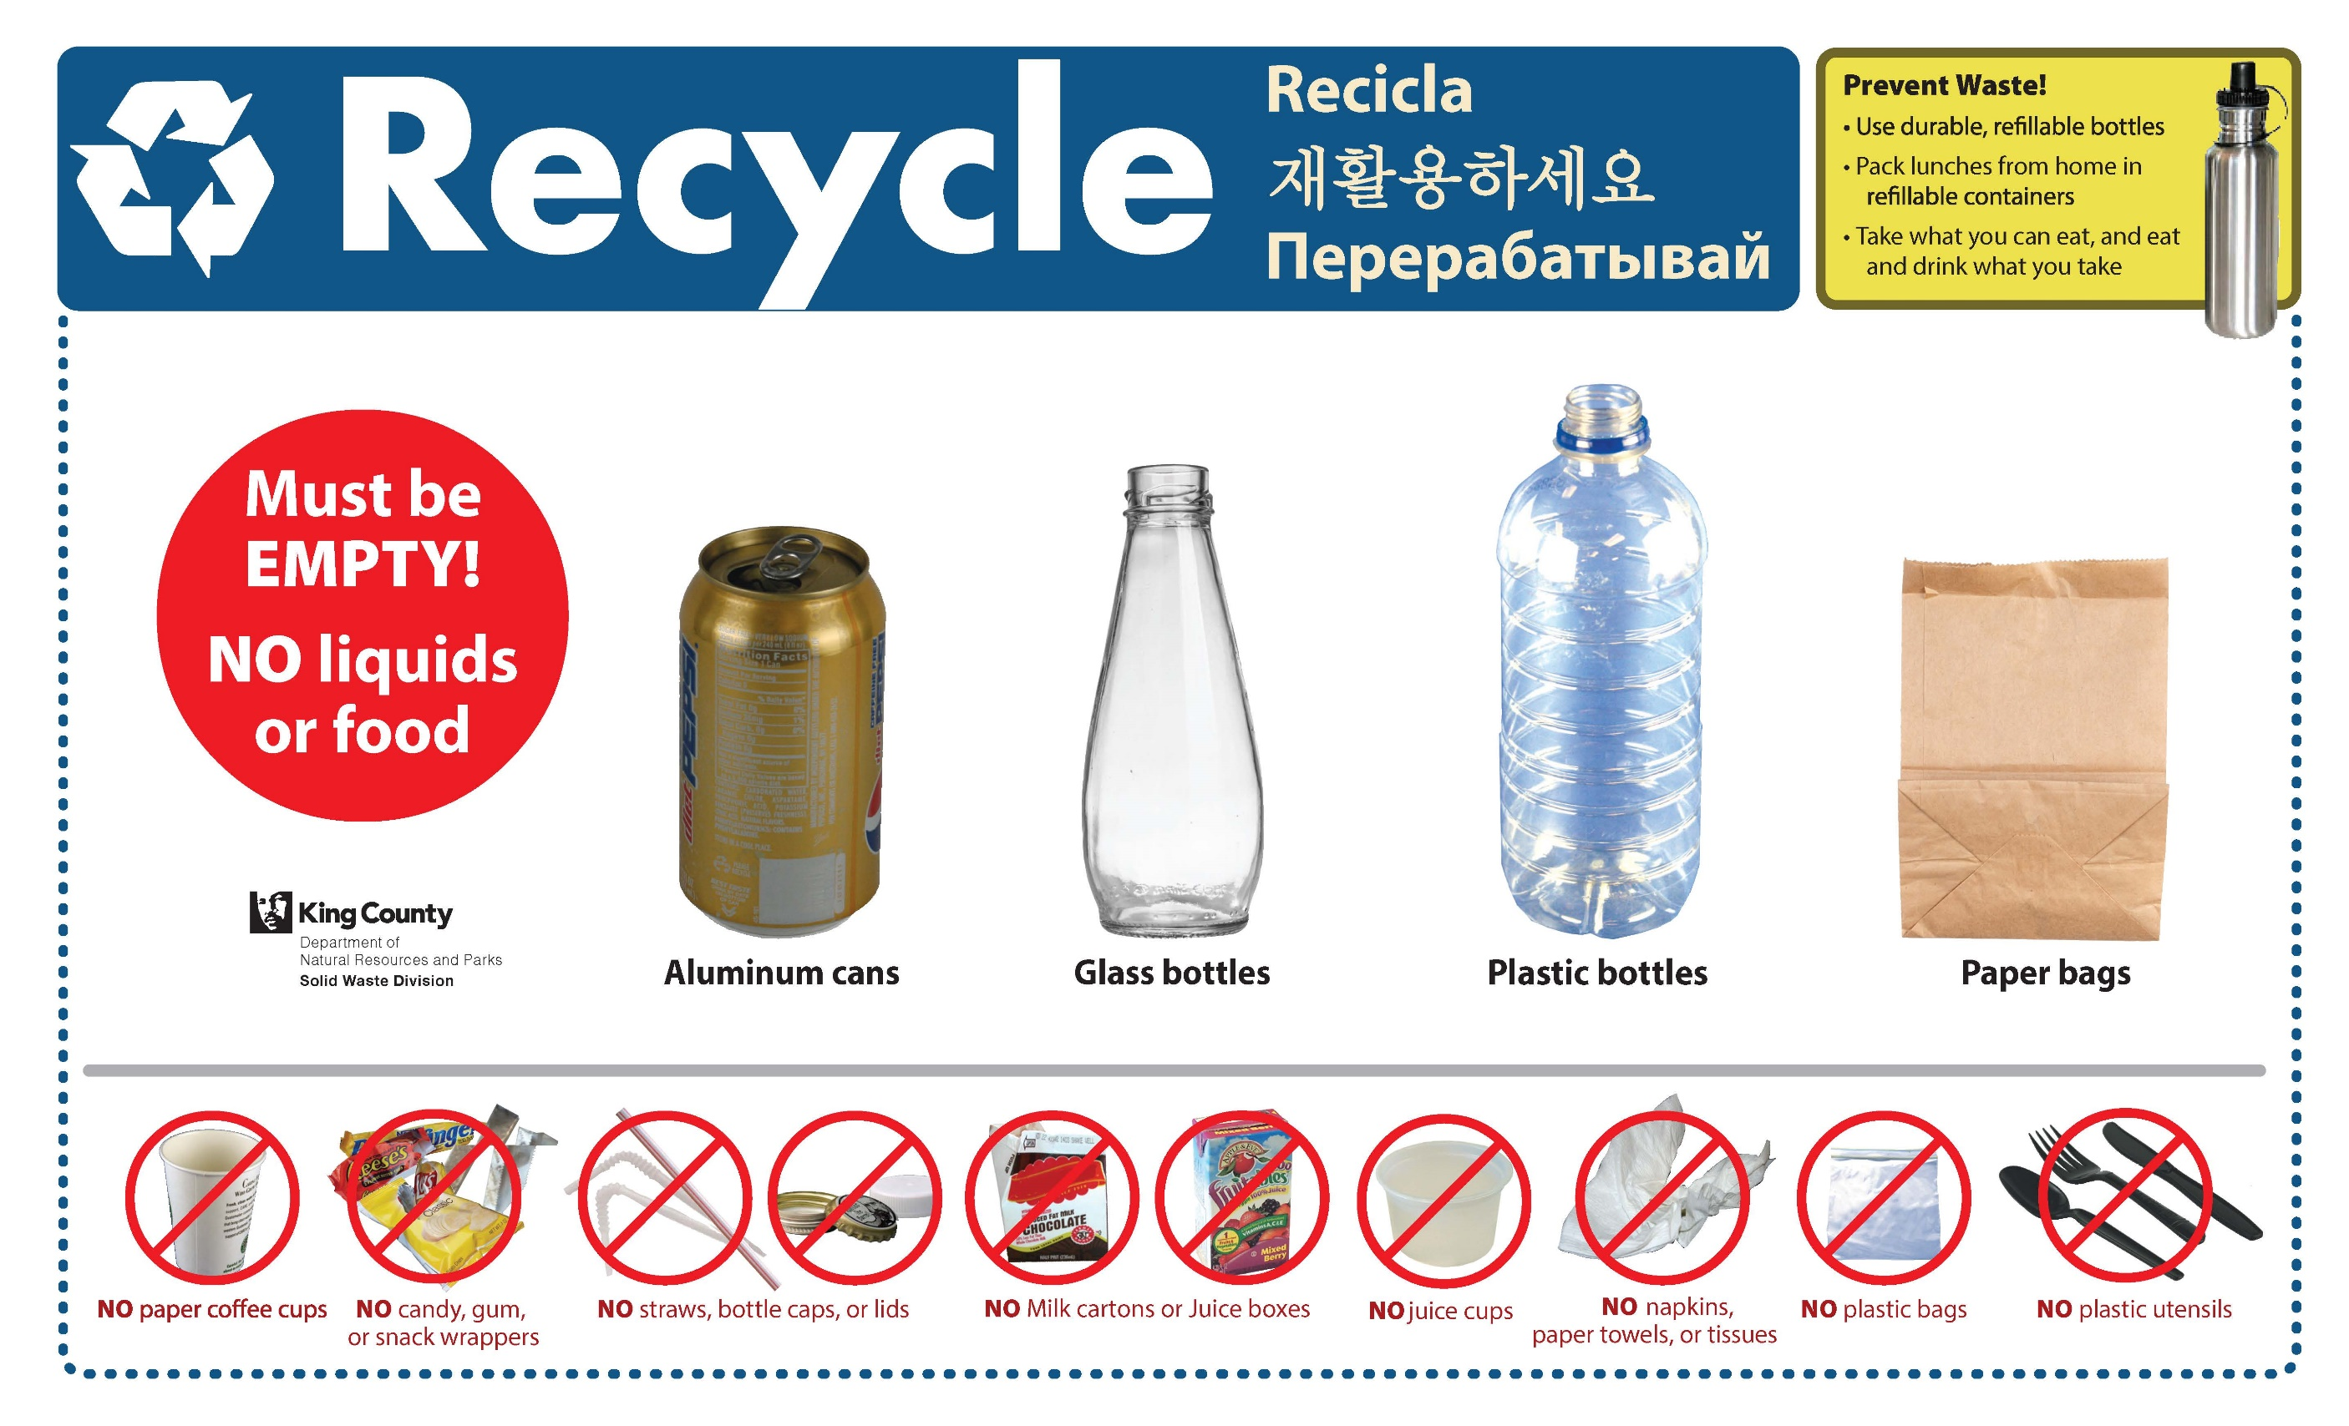
Blue is for recycling
Notes:
Blue is for recycling. What do you see on this sign for items that can go in the recycling? Recycling containers are for empty and clean plastic bottles, glass bottles and cans. In the classroom, paper and cardboard can also be recycled. Items like yogurt containers are recyclable at home because we can rinse them. At school we will throw yogurt containers away because we cannot rinse them. When in doubt if something is recyclable- throw it out.

Slide 14
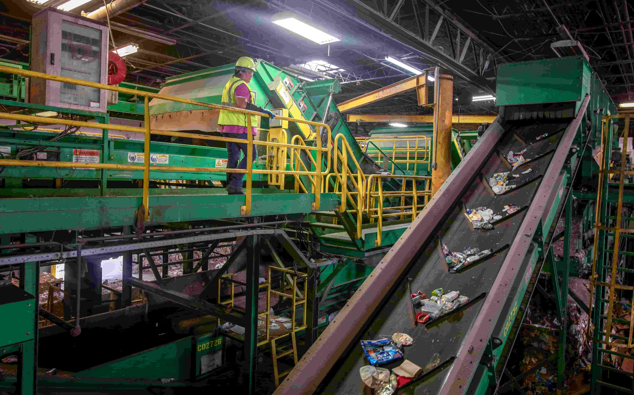
Materials collected for recycling are turned into new items.
Cans back into cans
Plastic bottles into bottles and other items.
Notes:
We recycle to keep items out of the landfill. Recyclables can be processed into new items. The photo below shows people sorting items. They can only pull out a few wrong items. If a recycling container is contaminated with many wrong items it will all need to be thrown away. That is why it is important to only recycle the correct items.

Slide 15
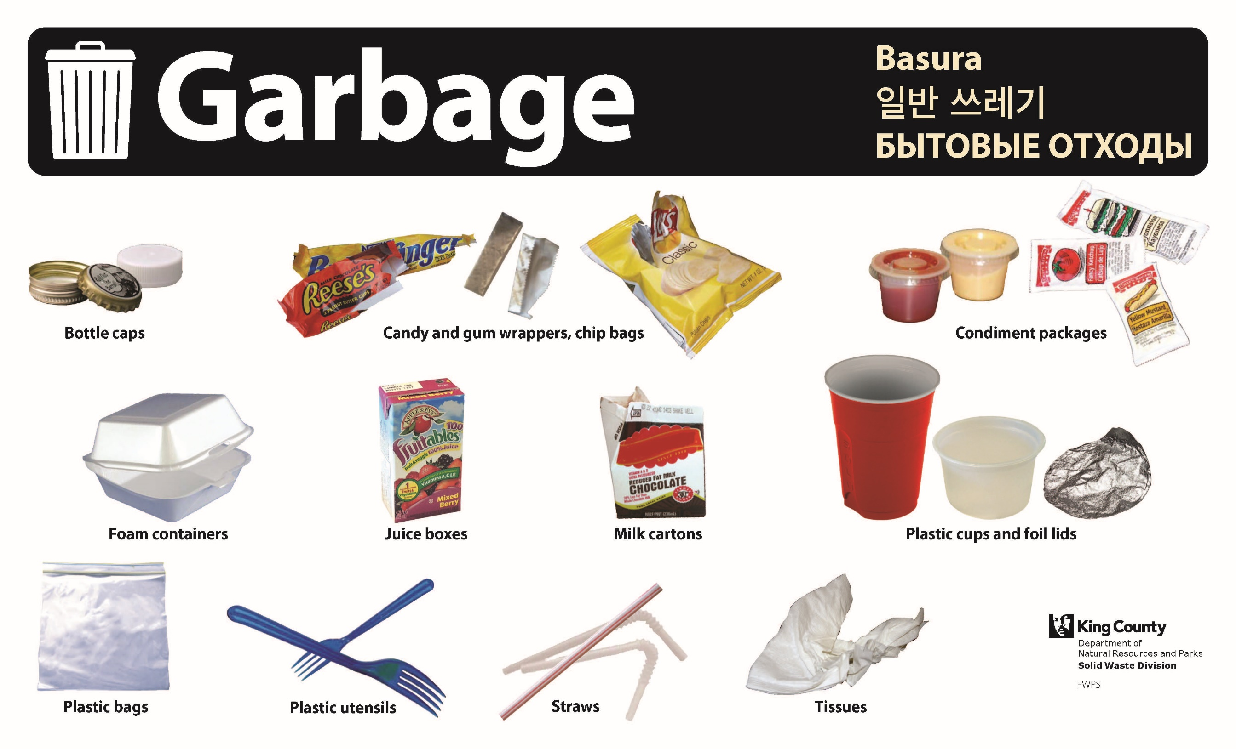
Grey is for garbage.
Notes:
Garbage is for items that are not recyclable or compostable. What do you see on this sign? loose caps, candy wrappers, potato chip bags, small plastic items, cups and yogurt containers, Ziplock bags, plastic utensils, straws, tissues. All of these items belong in the garbage. Who can repeat one of the items I just read?

Slide 16
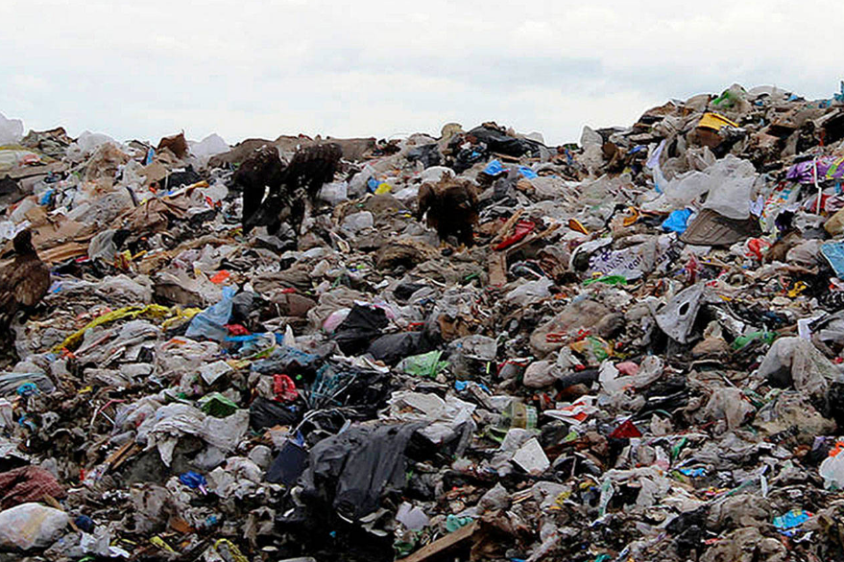
Garbage will go to a landfill.
Notes:
Items go to a landfill and sit there. While some items are garbage, we try to make sure recyclable items or compostable items do not end up here since they will not be used for anything else.

Slide 17
Let’s Practice Sorting!

Slide 18
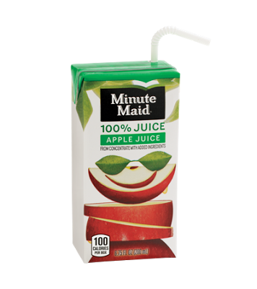
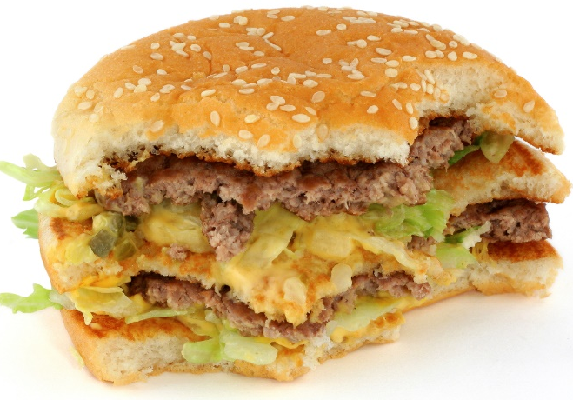
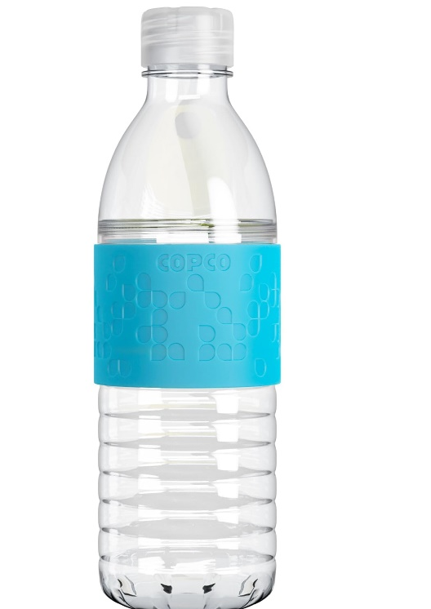
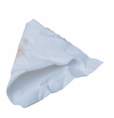
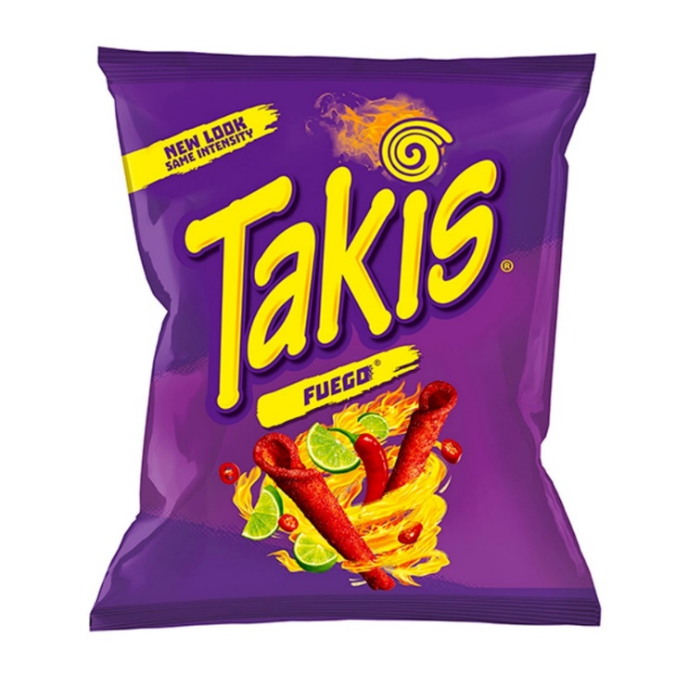
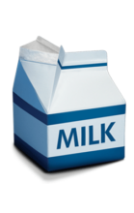
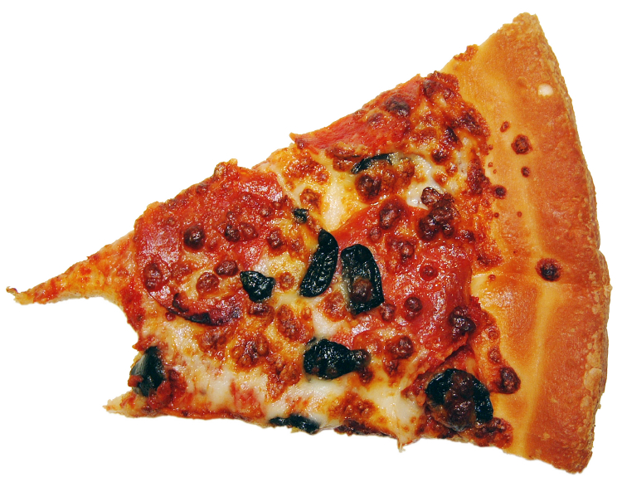
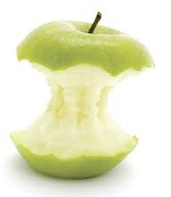
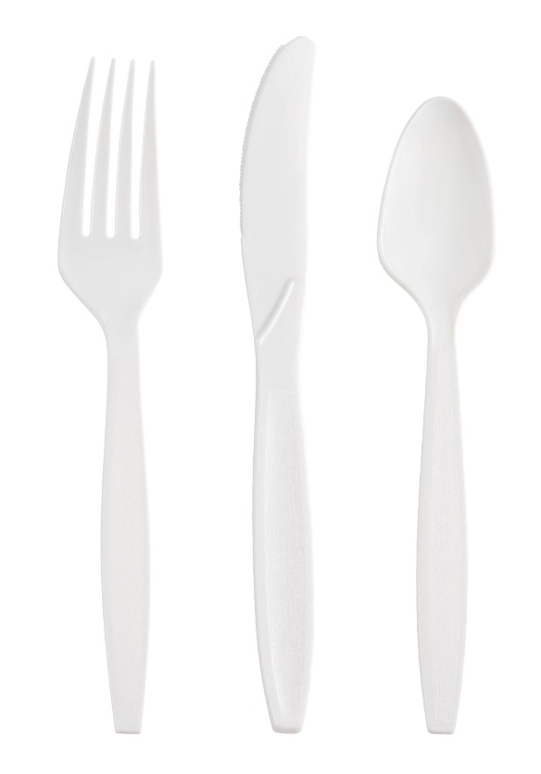
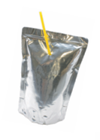
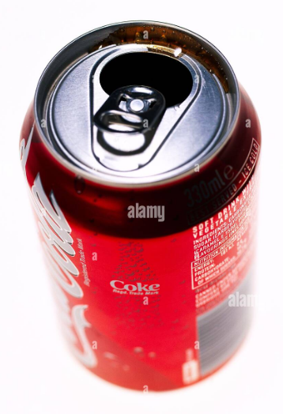
Which of these go in the compost?
There are 4 right answers!

Slide 19
Compostable items
Only food and napkins. These are the correct items. Remember NO Plastic.

Slide 20
Which of these go in the recycling?
There are 2 right answers!

Slide 21
Recyclable Items
Cans, glass bottles, plastic bottles go in the recycling in the cafeteria.
In the classroom, clean paper and cardboard is also recyclable.
Make sure these items are
EMPTY, CLEAN, and DRY before going into the recycling

Slide 22
Which of these go in the garbage?
Hint: it is anything that we haven’t already said is recyclable or compostable.

Slide 23
Garbage Items
When in doubt, throw it out. These items will go in the garbage: drink boxes,
Foil drink pouches, plastic utensils and straws, chip bags and candy wrappers,
Food cups, plastic Ziplock bags.

Slide 24

Remember, if you are ever confused where items go- look at the signs on the containers.
Notes:
Ask students.
Some answers: conserves natural resources, reduces wastes, cuts greenhouse emissions, allows us to make new products out of items that would be tossed, saves money, saves water, helps us keep water and air clean, helps wildlife, plus much much more!

Slide 25
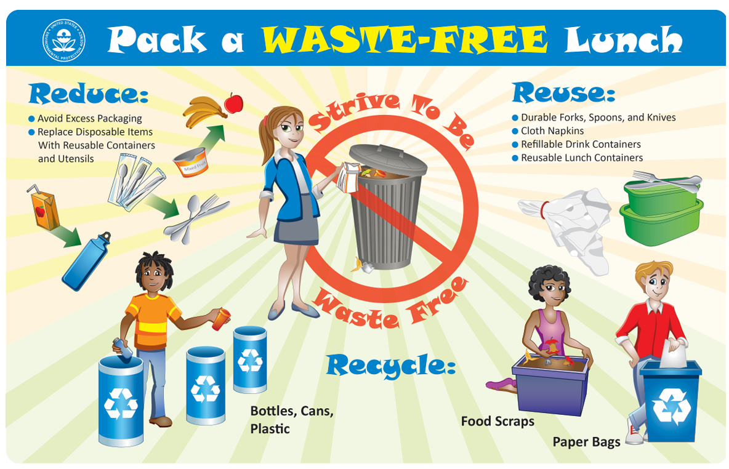
If you bring a lunch from home, try to reuse items to make a waste free lunch!
Pack A Waste-Free Lunch | US EPA

Slide 26
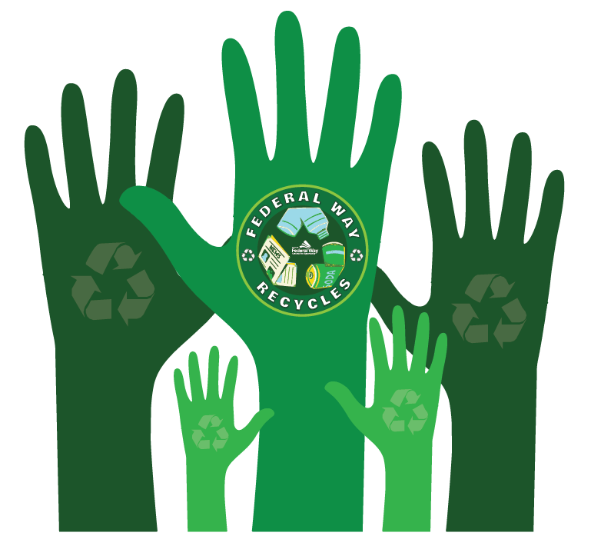
Take the pledge!
What is one thing you do to help our school reduce waste and sort properly?
Notes:
Will they pack a waste free lunch, finish their food, drink their milk, recycle properly, compost properly, save leftover items like crackers to eat later, put items in the share bins, others?

Slide 27
You are now sorting experts!
Thank You for Sorting Properly.
Questions?

