Slide 1


FWPS
Custodial Organics Training
August 6, 2025

Slide 2
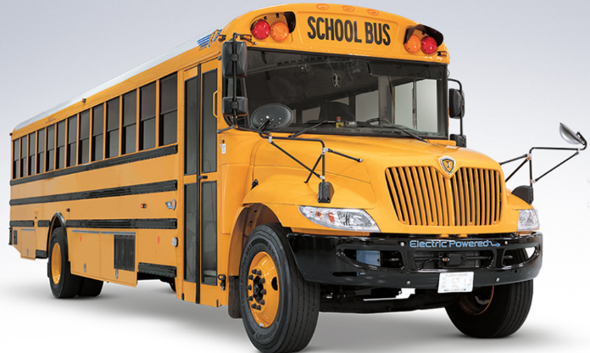
Amounts
Students make 14,500 tons of garbage per day.
That is the same weight as 2,000 school buses!
World Wildlife Federation estimates that each student in King County wastes 44 pounds of food per year at school. That is a lot!
Food Waste Warriors | Stories | WWF

Slide 3
All Schools in Federal Way School District will be launching composting/organics/food scrap collection in the cafeteria and kitchen on the first day of school this year.
We will cover details of the program today and what to expect.

Slide 4
Let’s become experts on which items belong in garbage, recycling and composting.

Slide 5
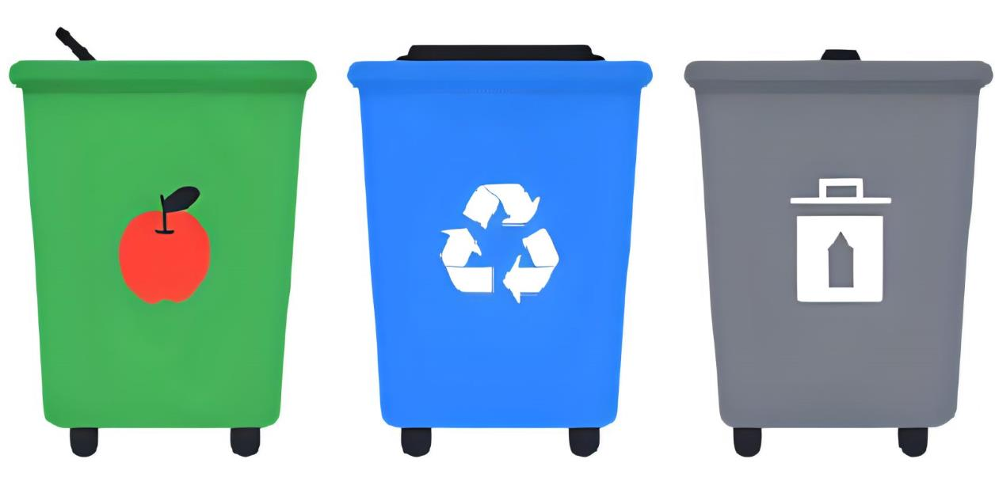



Green is for compost/organics
Blue is for recycle
Grey is for garbage

Slide 6

Containers are color coded for material.
This helps your school sort correctly.
Make sure your cafeteria is consistent and not using a color for the wrong materials.
Make sure all cafeteria containers have signs adhered to the container. Signs will be provided by King County.

Slide 7
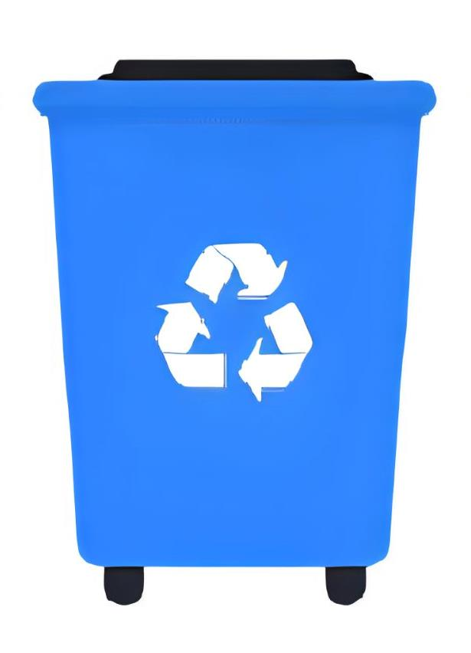
Question
Which items are acceptable for school recycling containers?

Slide 8
Blue is for recycling
Plastic bottles without the cap
Plastic cereal bowls
Plastic juice cups
Plastic bags
Plastic utensils and straws
Plastic cups
Plastic clam shell container (salad bar, cookies)
Capri Sun foil drink pouches
Drink boxes
Candy wrappers
Chip and snack bags
Ziplock bags
Styrofoam
Empty milk cartons
Metal cans- steel or aluminum
Aluminum foil
Non rinsed yogurt container
Shredded paper
Magazines
Classroom paper
Napkins
Tissues
Food boxes – like cereal boxes
Food service products that have held food
Broken down cardboard boxes
Empty glass bottles

Slide 9
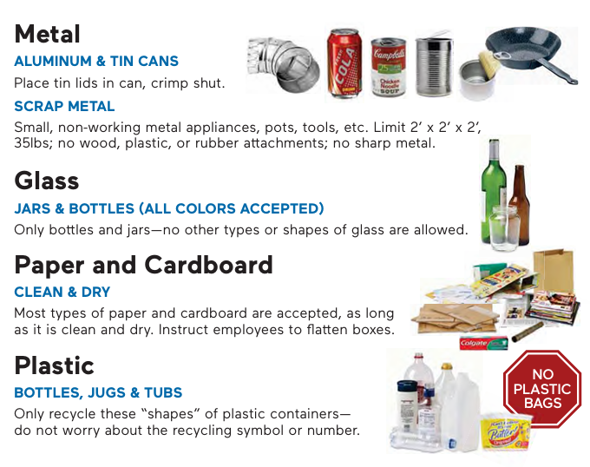
Blue is for recycling

Slide 10
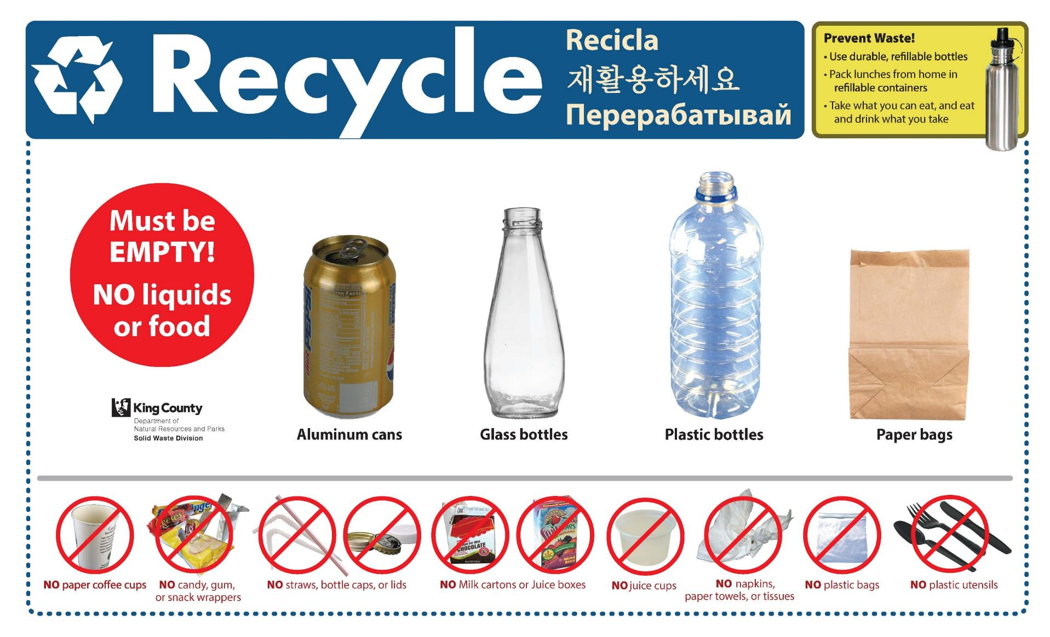
Cafeteria signs shows only main items used in the cafeteria.
Your school will get these on stickers to adhere directly to blue recycling containers.

Slide 11
Question
Should recycling be emptied loose into the outside dumpster or should it be bagged in a clear plastic bag?

Slide 12
Loose for recycling.
No bags please.

Slide 13
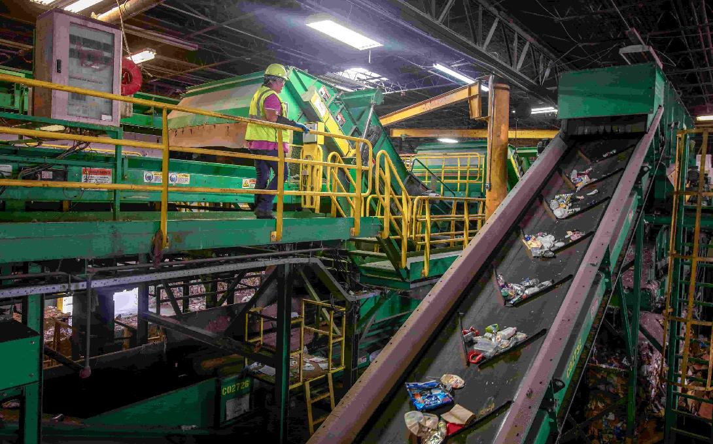
Materials collected for recycling are turned into new items.
Cans back into cans
Plastic bottles into bottles and other items.

Slide 14
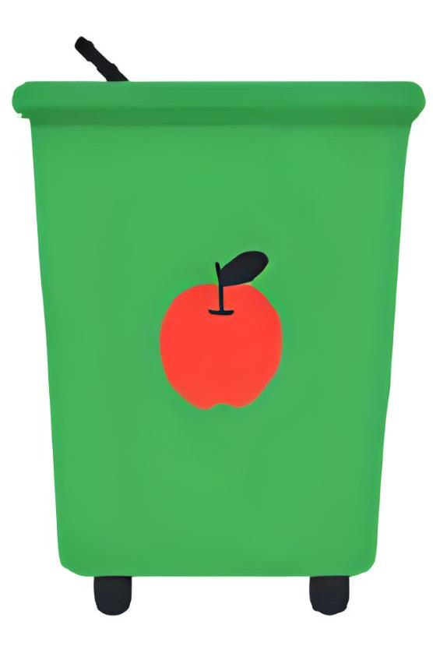
Question
Which items are acceptable for organics/composting container?

Slide 15
Green is for compost/organics
Vegetable scraps
Fruit scraps
Meat
Dairy
Liquids
Paper food serviceware
Plastic bags
Tissues
Napkins
Wooden chopsticks or popsicle sticks
Empty paper bags
Pizza boxes
Milk cartons

Slide 16
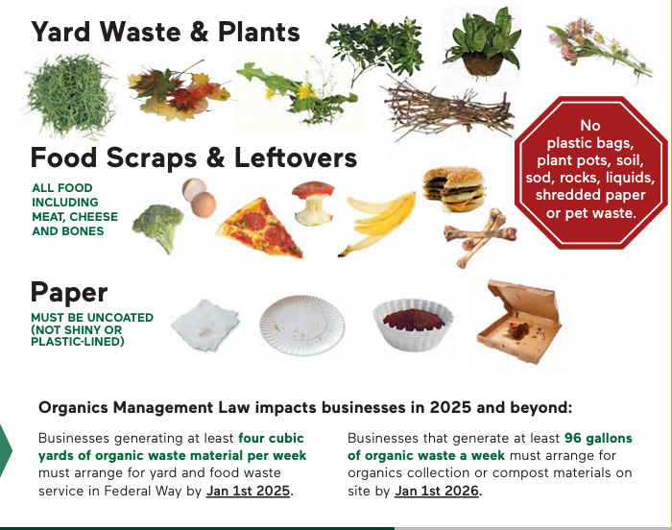
Green is for compost/organics

Slide 17
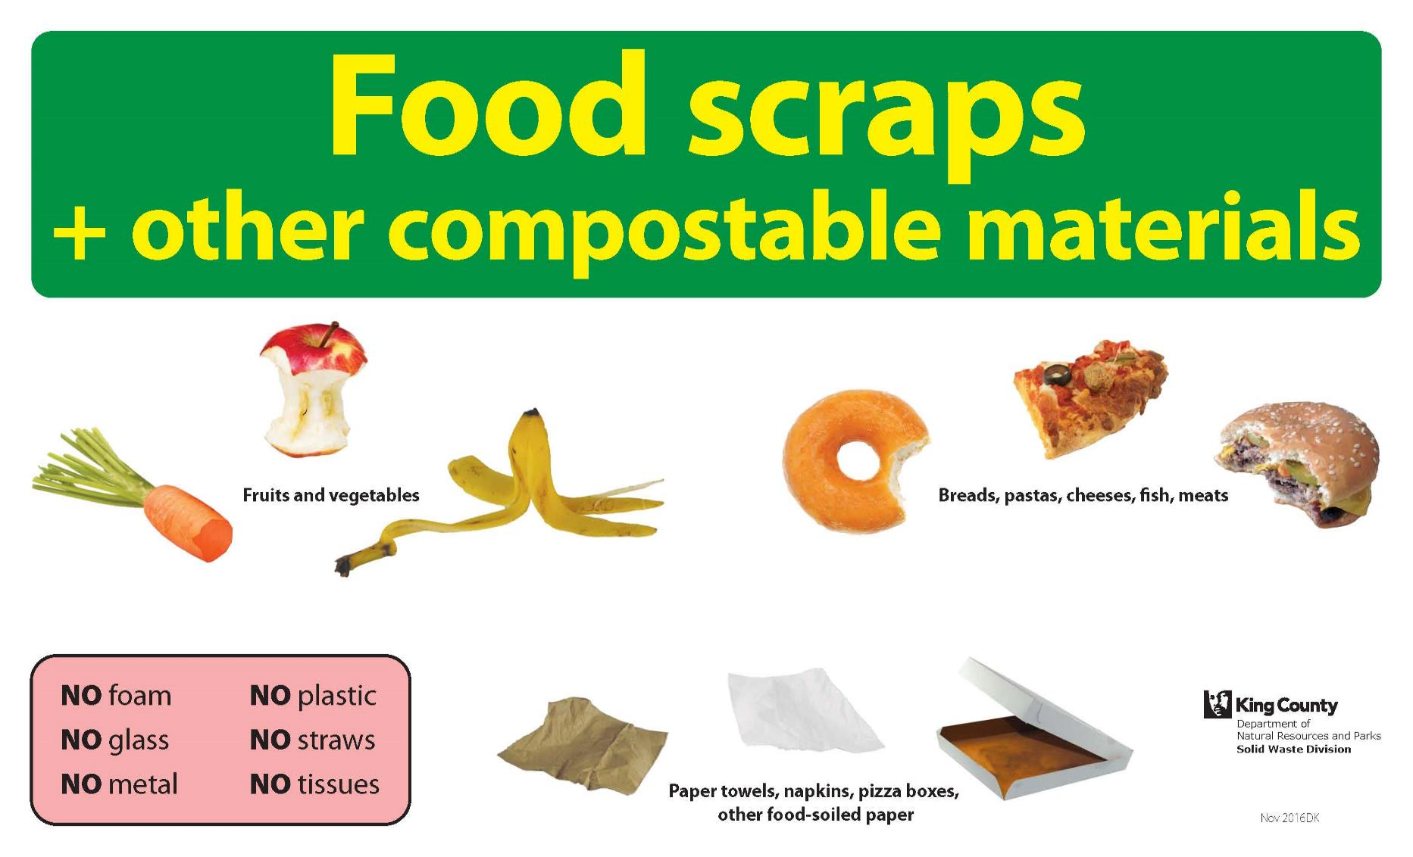
Cafeteria sign shows only main items in the cafeteria.
Your school will get these on stickers to adhere directly to green organics containers.

Slide 18
Top contaminants that cannot go in compost- to watch out for:
No Plastic bags (especially food in plastic bags)
No Plastic utensils
No Shiny paper products
No Gloves from the kitchen
No Pouring liquids in the compost
No Paper bag filled with incorrect items

Slide 19
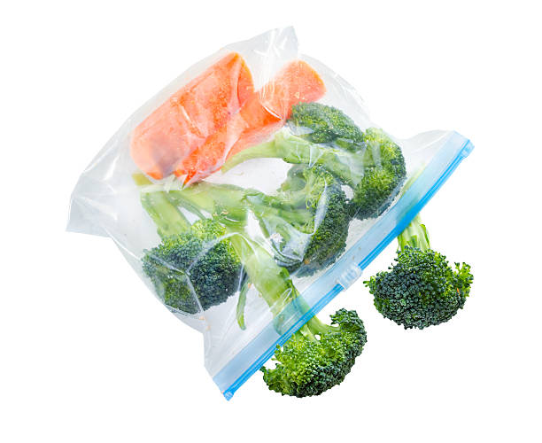
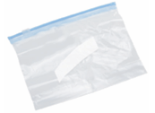

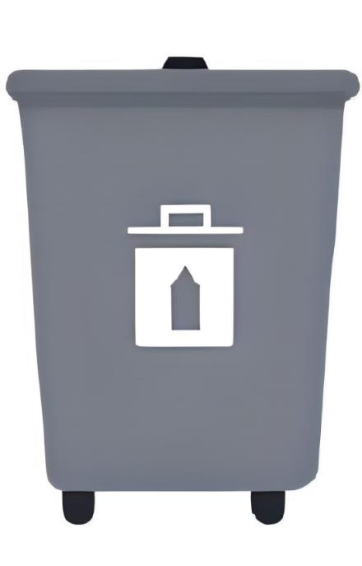
Emptying food from plastic bags
Students need to empty loose food in the compost container.
They need to throw the empty plastic bag away.
NO PLASTIC IN THE COMPOST.

Slide 20
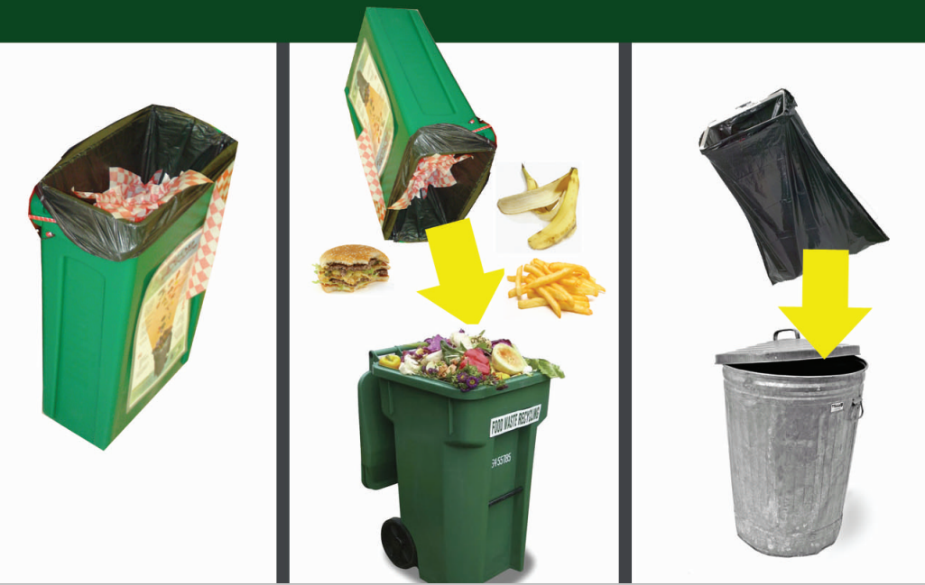
How to empty compost. No bags. Line inside containers with plastic bags, but empty materials loose in outside carts and throw the plastic bag away.

Slide 21
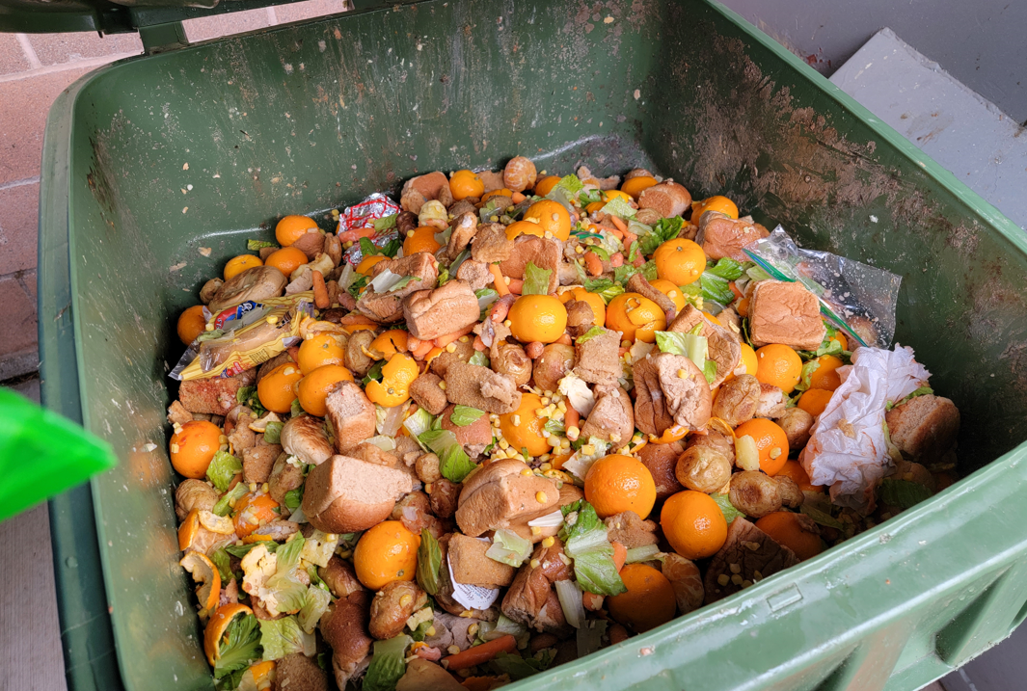
Compost should look like.
Be sure food waste is loose- no bags.
If recycle or compost are contaminated more than 5%, toss it. Let the Principal know so they can help educate students.
Never- should you be sorting through items.

Slide 22
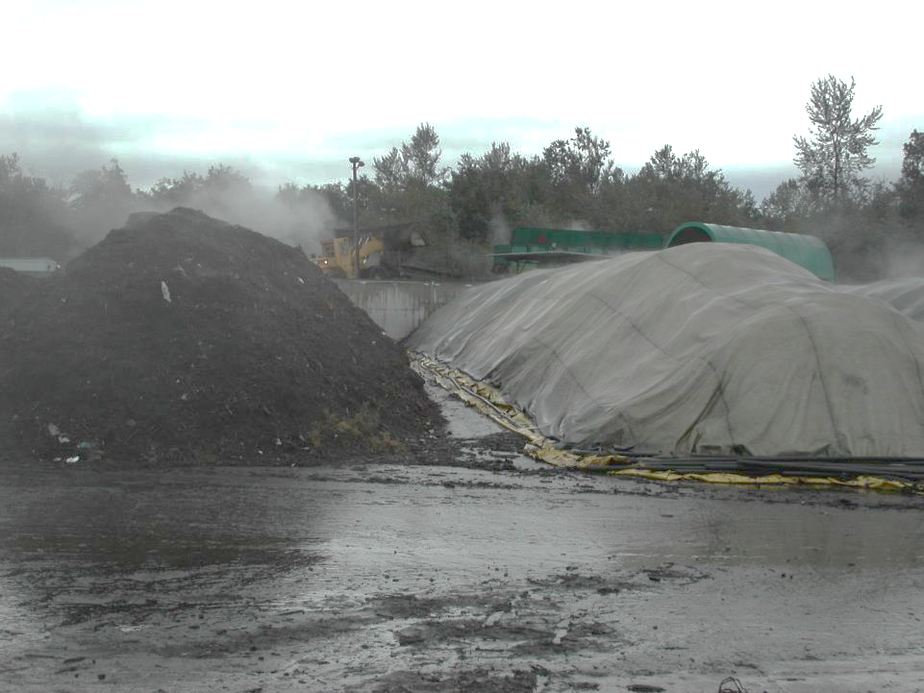
Food scraps are composted into new soil in just 8 weeks and used on local gardens.

Slide 23

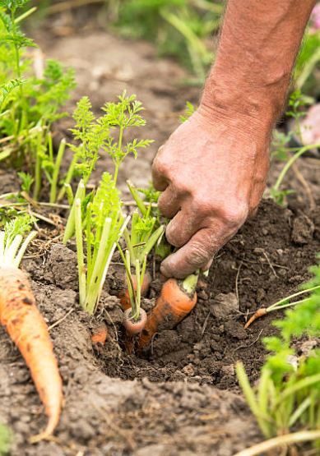
What is better than composting food?

Slide 24
What is better than composting food?
For students to eat their food and finish their milk!

Slide 25
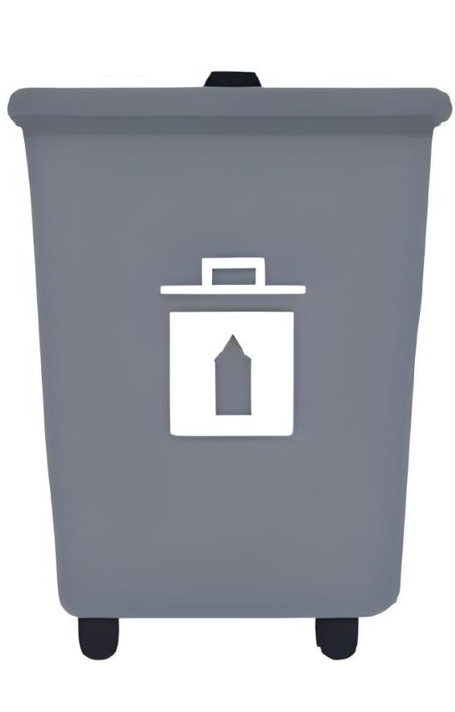
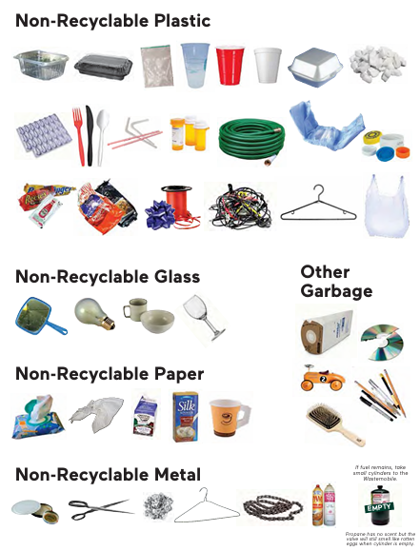
Grey is for garbage.

Slide 26
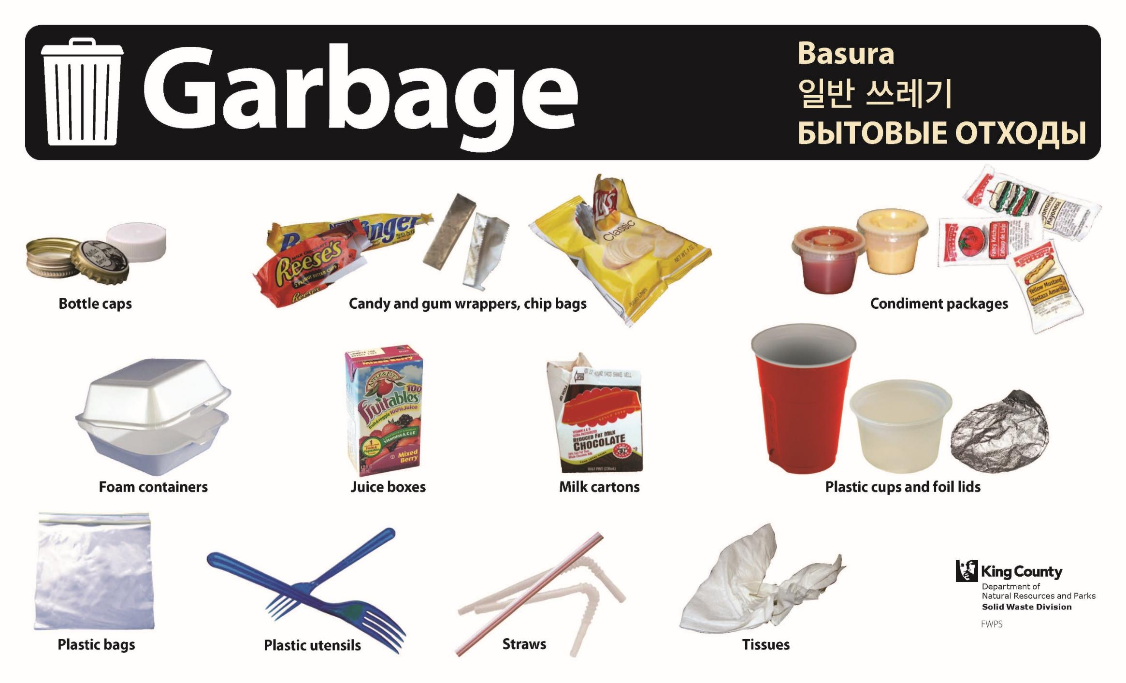
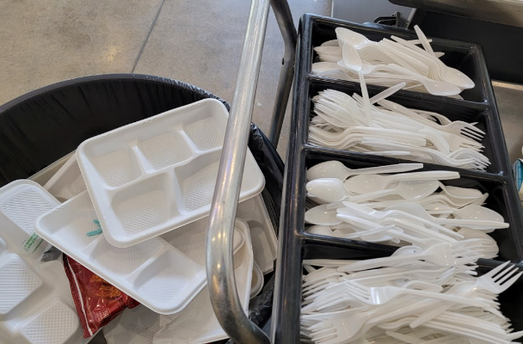
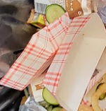

Slide 27
How to empty garbage. Have students close milk cartons and throw in the garbage.
Bag garbage, tie it off and throw in outside dumpster.
Recycling and compost are loose.
Garbage is to be bagged.

Slide 28
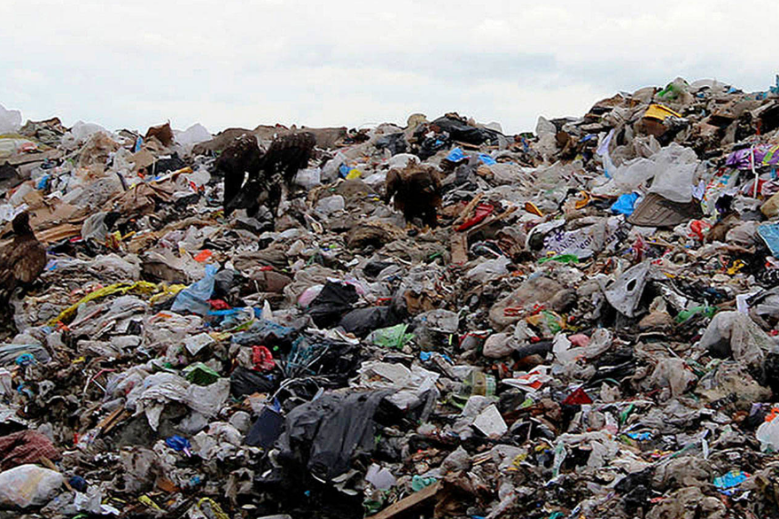
Garbage will go to a landfill.

Slide 29
Resource Guide:
www.federalwaywa.gov/page/commercial-composting-resources
The next slides are from the new City resource guide that is online:

Slide 30
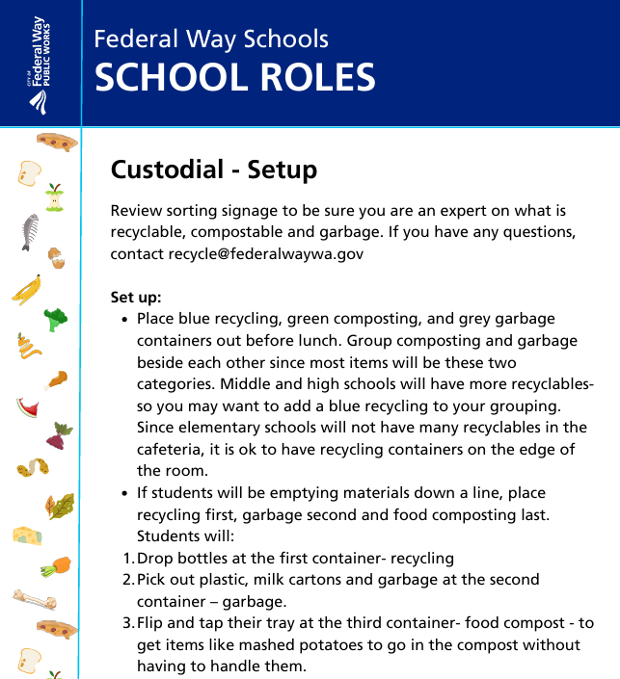
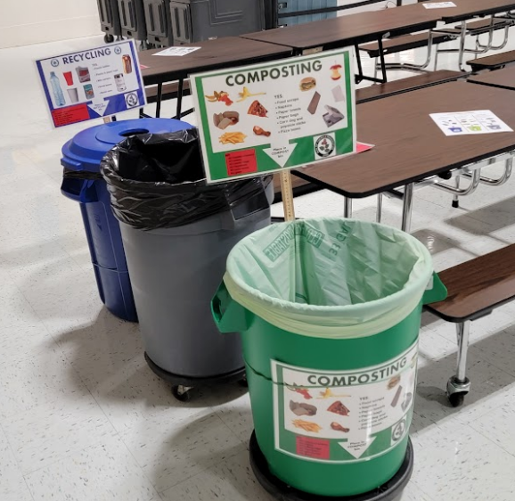
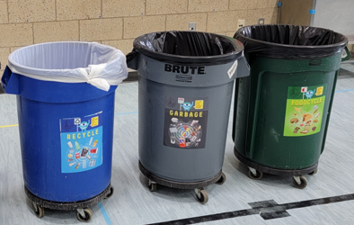

Slide 31
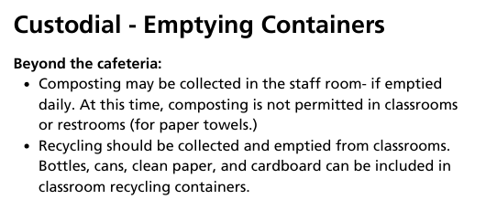

Slide 32
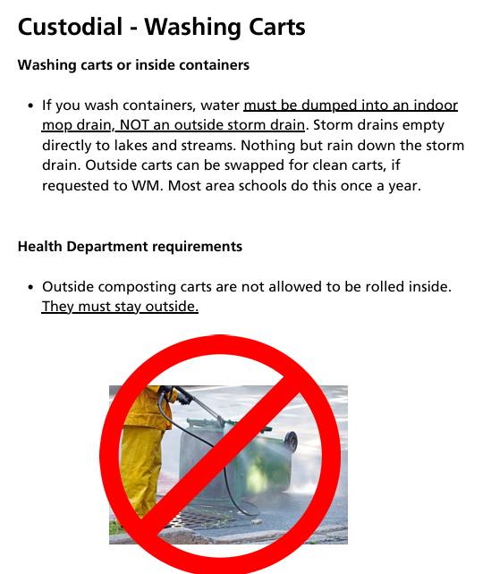

Slide 33
Questions?
Contact: recycle@federalwaywa.gov

